Slide 1

The MVP Formula
Using AI to Predict NBA Player Success (2010-2024) By Team Data Dribblers
An analytical deep dive from draft to dominance, revealing how data science decodes elite talent acquisition and on-court dominance.

Slide 2
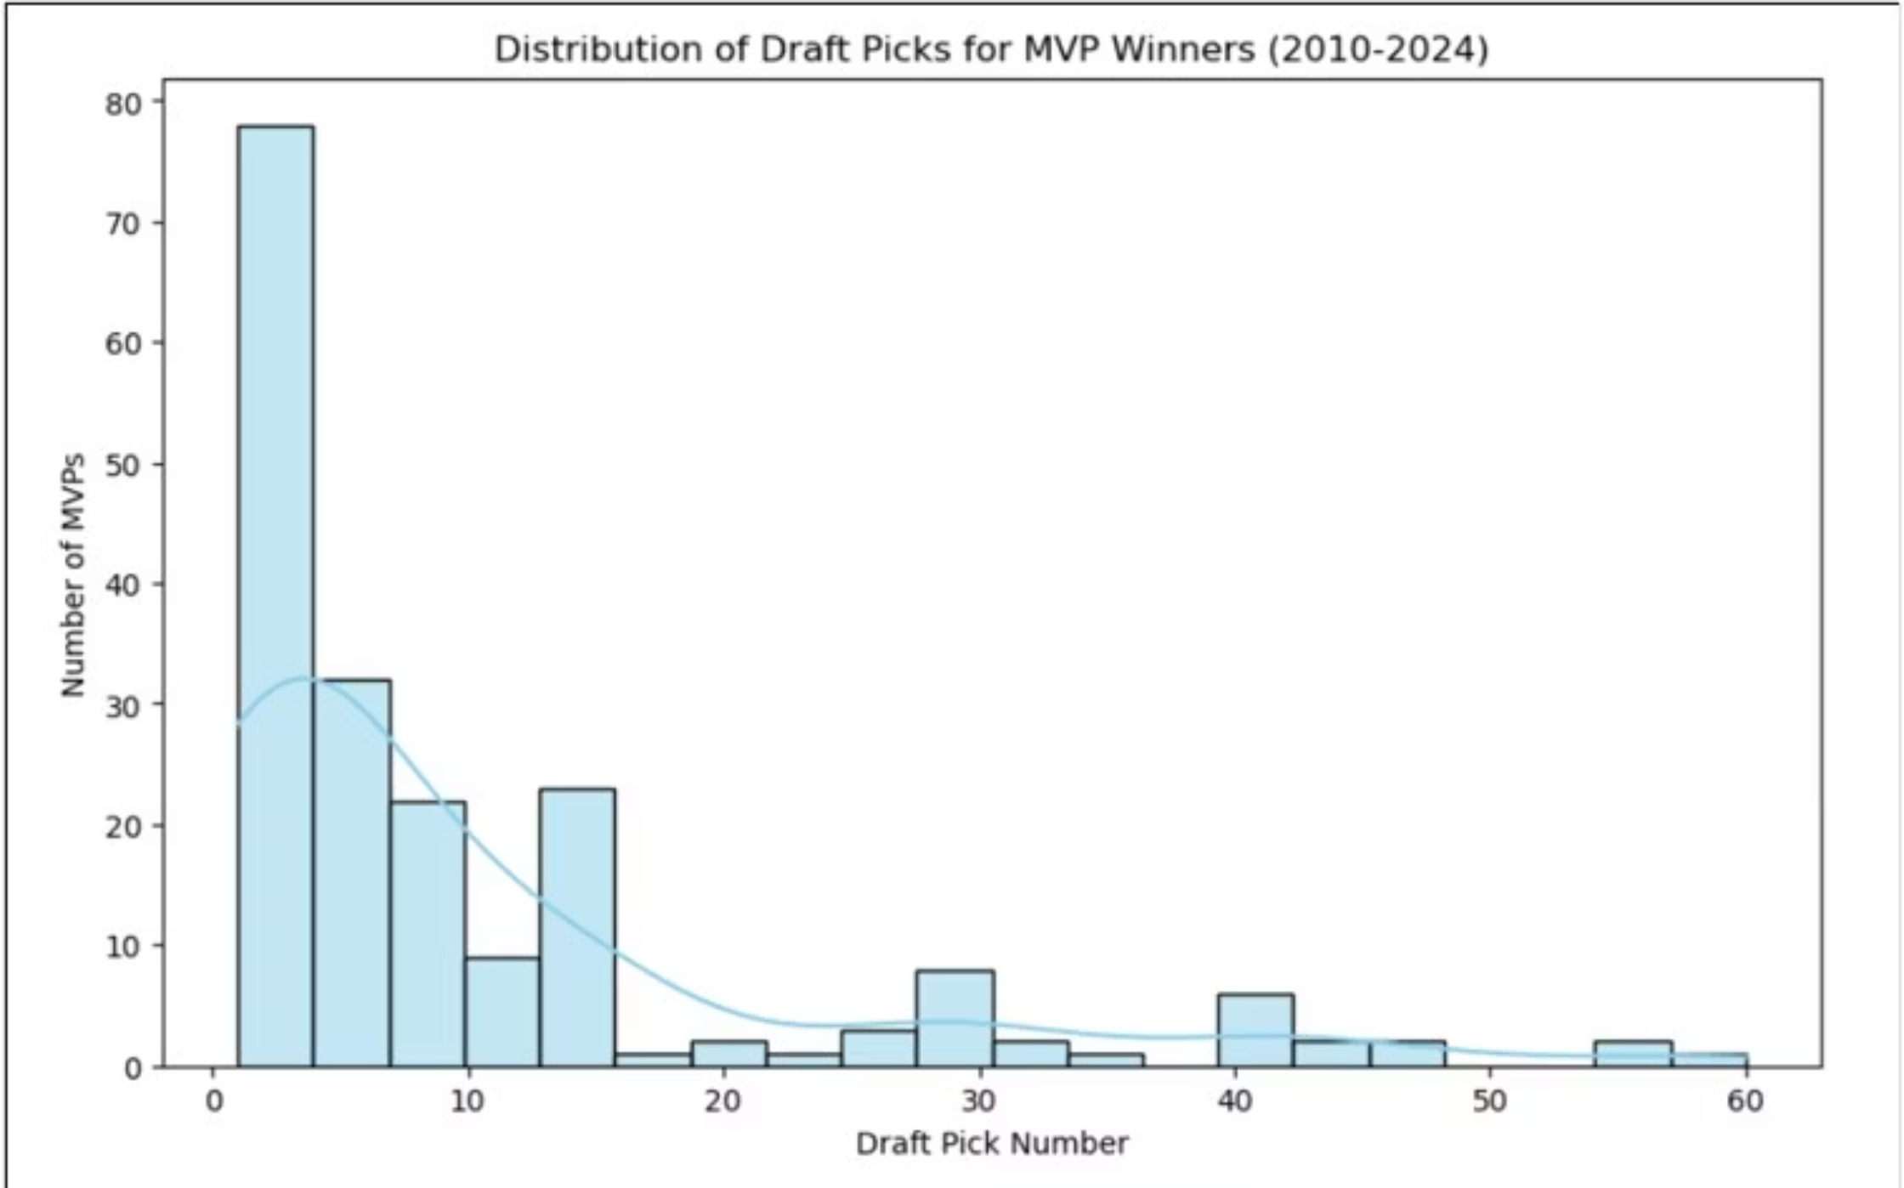
Talent Pipeline: Where MVP Winners Originate
Most MVP winners (2010-2024) were drafted early, validating traditional scouting. Yet recent outliers—Jokić, Giannis—reveal that exceptional talent can emerge from unexpected places, forcing teams to refine their talent evaluation strategies.

Slide 3
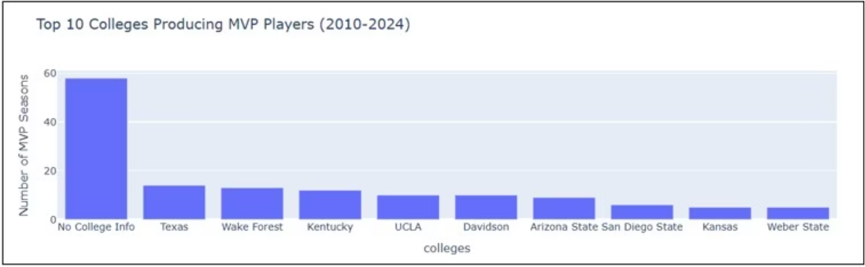
College vs. The World: Elite Talent Factories
Elite colleges remain crucial pipelines for MVP-caliber talent. However, the rising "International/Non-Traditional" category signals a fundamental shift: global talent markets are expanding, and traditional scouting pathways alone no longer capture the full talent landscape.

Slide 4

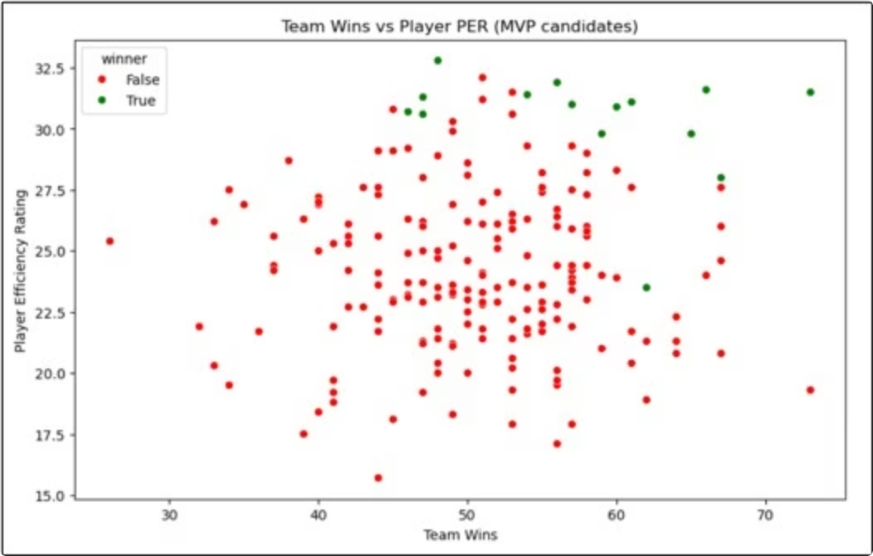
The Winning Equation: Efficiency Meets Championship-Caliber Success
MVP winners cluster in the top-right quadrant: high team wins and high player efficiency (PER). This reveals the MVP award's dual imperative—elite individual performance must drive team-wide success. Efficiency alone doesn't guarantee recognition; dominance on a losing team remains undervalued.
Key Insight: MVPs elevate their entire team. The award rewards not just personal excellence, but impact on winning.

Slide 5
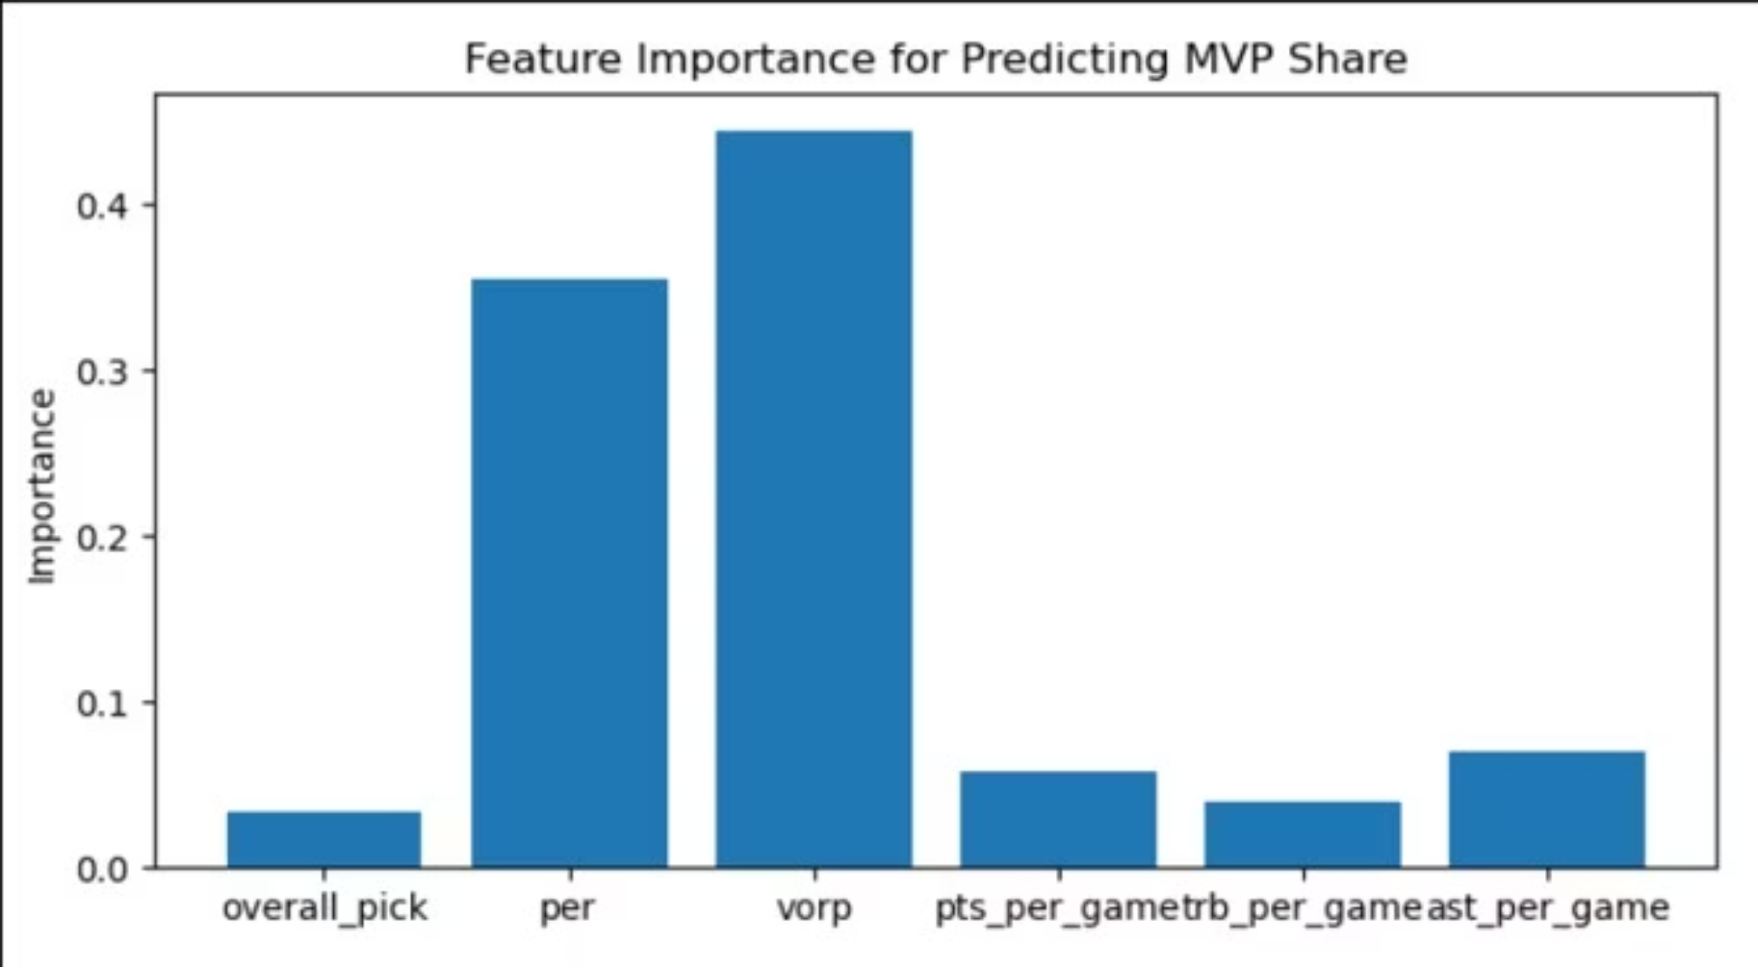
AI's Verdict: What Truly Predicts MVP Success
Machine learning models reveal which metrics matter most. Advanced efficiency statistics—VORP (Value Over Replacement Player) and PER (Player Efficiency Rating)—dominate predictive importance. Traditional volume stats (points, rebounds, assists) rank significantly lower, validating the modern analytics revolution.

Slide 6

Data-Driven Scouting
The Path Forward
Early Picks Matter
Global Talent Rising
Efficiency Reigns
Top-10 draft picks still dominate MVP ranks, but outliers prove talent evaluation requires adaptive scouting.
International and non-traditional pathways now represent 20%+ of elite talent. Expand scouting networks globally.
VORP and PER predict MVP success better than volume stats. Prioritize impact efficiency in evaluations.
Takeaway: Teams that combine traditional scouting with advanced analytics, embrace international talent, and prioritize efficiency metrics will identify and develop elite players more reliably. Data science reduces bias and sharpens competitive advantage.

